Slide 1


Settling into Semantic Space
An Ambiguity-Focused Account of Word-Meaning Access
Jenni Rodd
University College London

Slide 2
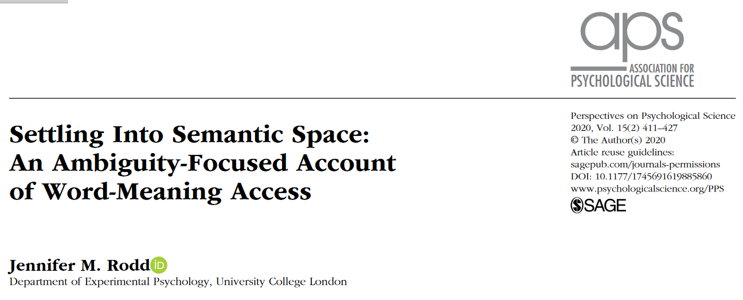
Access:
https://jennirodd.com/publications/

Slide 3

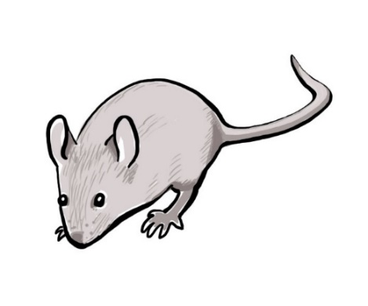
How do we know what words mean?
mouse

Slide 4
New Account of Word-Meaning Access
3 Key features:
Connectionist (neural network) framework
Multiple cues influence settling dynamics
Learning mechanisms shape/maintain lexical knowledge.
Rodd et al. (2020), Perspectives in Psychological Science

Slide 5
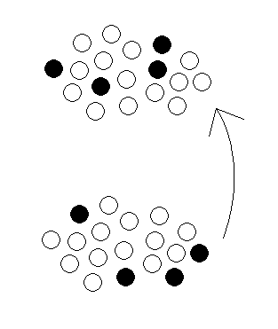
Connectionist Models of Word-Meaning Access
Semantics
Orthography
or
Phonology
Hinton & Shallice (1991)
Masson (1991)
Plaut & Shallice (1993)
Joordens & Besner (1994)
Masson (1995)
Devlin et. al. (1997)
Gaskell & Marslen-Wilson (1997)
Plaut (1997)

Slide 6

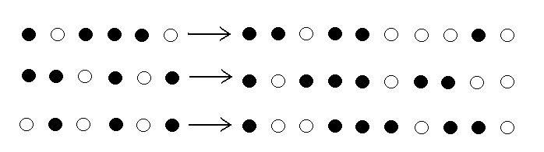


Limitation of most Connectionist Models
Each word’s meanings represented by single pattern
one-to-one mapping between form and meaning
Ant
Tiger
Church

Slide 7
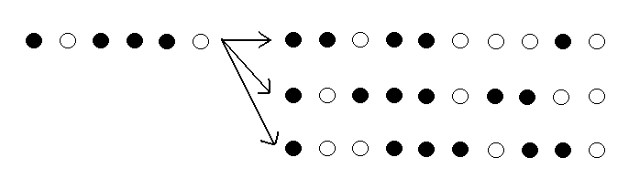



Lexical-Semantic Ambiguity
Most words have a one-to-many mapping
Shell
Shell

Slide 8
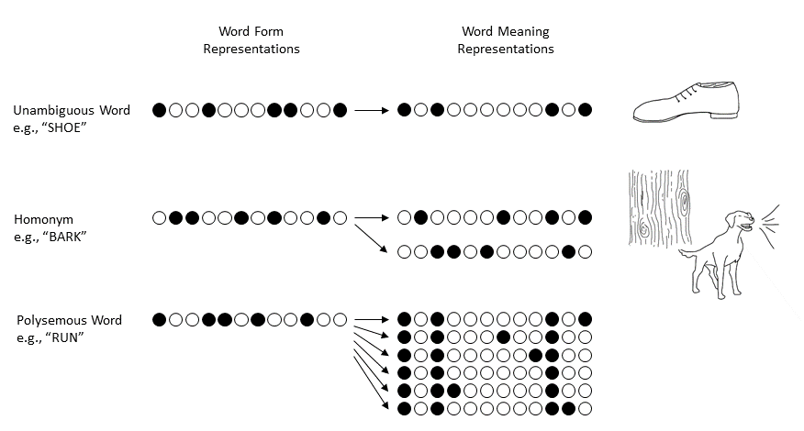
Word Types Differ in their Form-Meaning Mapping
GRADED DISTINCTIONS

Slide 9

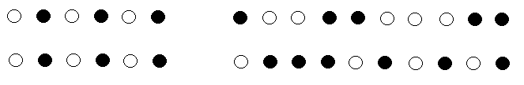
The Importance of Semantic Structure
A standard feed-forward network cannot learn
one-to-many mappings
bark

Slide 10

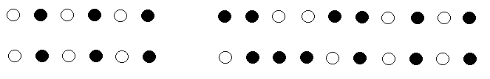
The Importance of Semantic Structure
A standard feed-forward network cannot learn
one-to-many mappings
bark

Slide 11
The Importance of Semantic Structure
A standard feed-forward network cannot learn
one-to-many mappings
?
bark

Slide 12
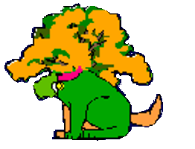
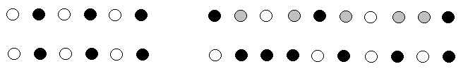
The Importance of Semantic Structure
After training the output would always be a blend of the two meanings
bark
People don’t do this!
Learned knowledge of co-occurrence of semantic features supports disambiguation
Ensures settling into stable, familiar meaning
“attractor basin”

Slide 13

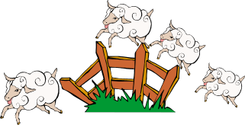


How do we get the “RIGHT” meaning?
Structure of stored knowledge
  Frequency/Dominance
  e.g. “the PEN”
2) Cues in immediate environment
SENTENCE CONTEXT
e.g., “The tree/dog BARK”
Knowledge about the speaker/writer
Etc etc etc…

Slide 14
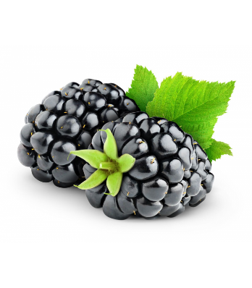
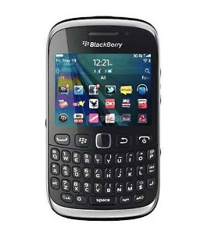
Meaning Availability: Stable or Flexible?
blackberry

Slide 15
Using Web-based Experimental Methods
Typically use:
Prolific Academic for recruitment
Gorilla for stimulus presentation
“How to Maintain Data Quality When You Can’t See Your Participants”
Article in APS Observer Magazine:
https://www.psychologicalscience.org/observer/how-to-maintain-data-quality-when-you-cant-see-your-participants
Video of Talk at BeOnline Conference:
https://beonline.research.sc/videos

Slide 16
Meaning Availability: Stable or Flexible?
blackberry

Slide 17

Evidence for flexibility
Meaning Preferences in Adult Rowers
Rowers acquire additional meanings for common words: “square”, “feather”
What determines relative preferences for these meanings?
Web-based word association (N=213)
  FEATHER: bird vs. FEATHER: oar
Rodd et al., 2016

Slide 18
Multiple Regression Analyses
Rodd et al., 2016

Slide 19
Multiple Regression Analyses

Slide 20
Effect of recent rowing experience
Median delay between rowing and experiment: 8 hours

Slide 21

Word Meaning Priming: On the radio…
BBC Radio 4: “The Human Zoo”
1) Listeners heard descriptions that included 28 Ambiguous words
    Mark hopes to become a professional tennis player. He practises on court at his club with his coach most days. His strongest weapon on court is his serve. He regularly gets out of trouble in a match with an ace on his serve. In his last match Mark saved three set points with an ace.
2) Web-based word association task
Are responses influenced by radio primes?
N=2525
Rodd et al., 2016

Slide 22
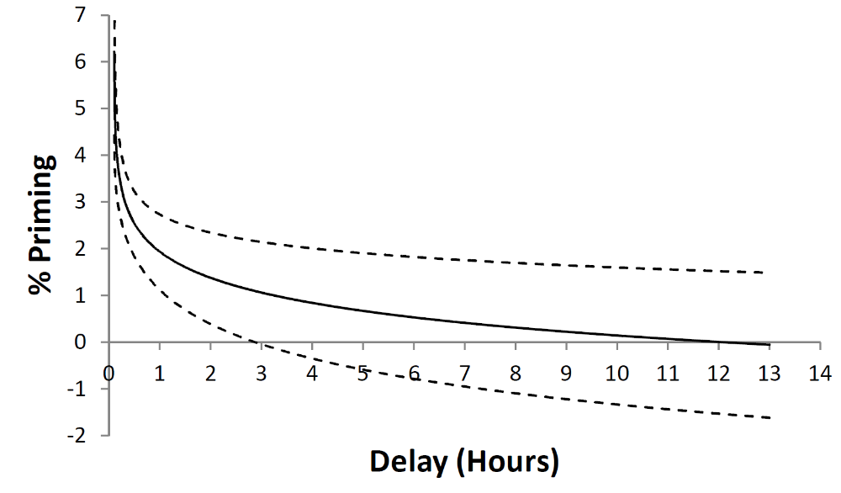
Influence of primes as function of delay:
Regression analysis
Best Fit: Logarithmic Function

Slide 23
Back in the lab…
Rodd et al., 2016

Slide 24
Recent and Long-term Experience
Adult meaning preferences for familiar words are HIGHLY flexible
Large effects of same-day encounters
3. Repeated encounters have substantial long-term cumulative effect (aka “dominance effects”)
“Dominance” varies across individuals
“Dominance” varies across time
Learning improves ease of comprehension

Slide 25
Some Questions about Cognitive Mechanism
Is this just semantic priming?
  Rodd et al., (2013)
Do multiple encounters have cumulative effect?
Betts et al., (2018; JEP: LMC)
3. Does the spacing of encounters matter?
Betts et al., (2018; JEP: LMC)
4. Is learning modality specific?
  Gilbert et al., (2018; JEP: LMC)
5. Is sleep-dependent consolidation involved?
  Gaskell et al., (2018; Cognition)
Only at short delays
(up to ~3 minutes)
Yes
It is complicated!
No
Yes

Slide 26
Some More Questions about Mechanism
6. Does sentence structure matter?
  Gilbert et al., (2021; JML)
7. What happens if we prime both meanings?
Gutiérrez et al., (in prep)
8. Can learning transfer across languages
Poort & Rodd (2016, BL&C; in prep)
9. Do similar effects arise for unambiguous words?
  (Gaskell et al., in prep)
No
Boost for subordinate meaning
For interlingual homographs
But weakly
Yes!

Slide 27
How do we get the “RIGHT” meaning?
Structure of stored knowledge
  Frequency/Dominance
  e.g. “the PEN”
2) Cues in immediate environment
SENTENCE CONTEXT
e.g., “The tree/dog BARK”
Knowledge about the speaker/writer
Etc etc etc…

Slide 28

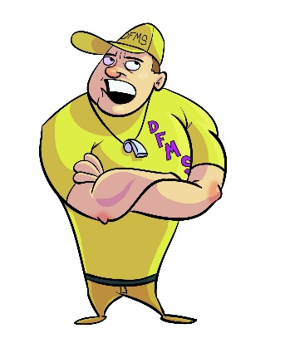


Cai et al., (2017): Speaker Characteristics
COACH
?
COACH
?

Slide 29
Stimuli
22 ambiguous words
Different dominant meanings in UK vs US English
e.g., FALL, FLAT, GUTTED, PLASTER, TUBE
Meaning familiarity rated by US and UK participants
(visually presented)
Recorded by UK and US female speakers
  Cai et al., 2017; Cognitive Psychology

Slide 30
Experiment 1
METHOD
Online word association task
US participants
  32 heard US accent
  31 heard UK accent
UK participants (via social media)
  25 heard US accent
  32 heard UK accent
  Cai et al., 2017; Cognitive Psychology

Slide 31
RESULTS

Slide 32
Experiment 1: Conclusions
Speaker accent influences how UK participants interpret words
No significant accent effect in US participants
But what is the mechanism?
Accent context
Detailed acoustic/phonetic information in individual tokens (cf Episodic accounts)
Evidence from follow-up experiments supports (1)

Slide 33
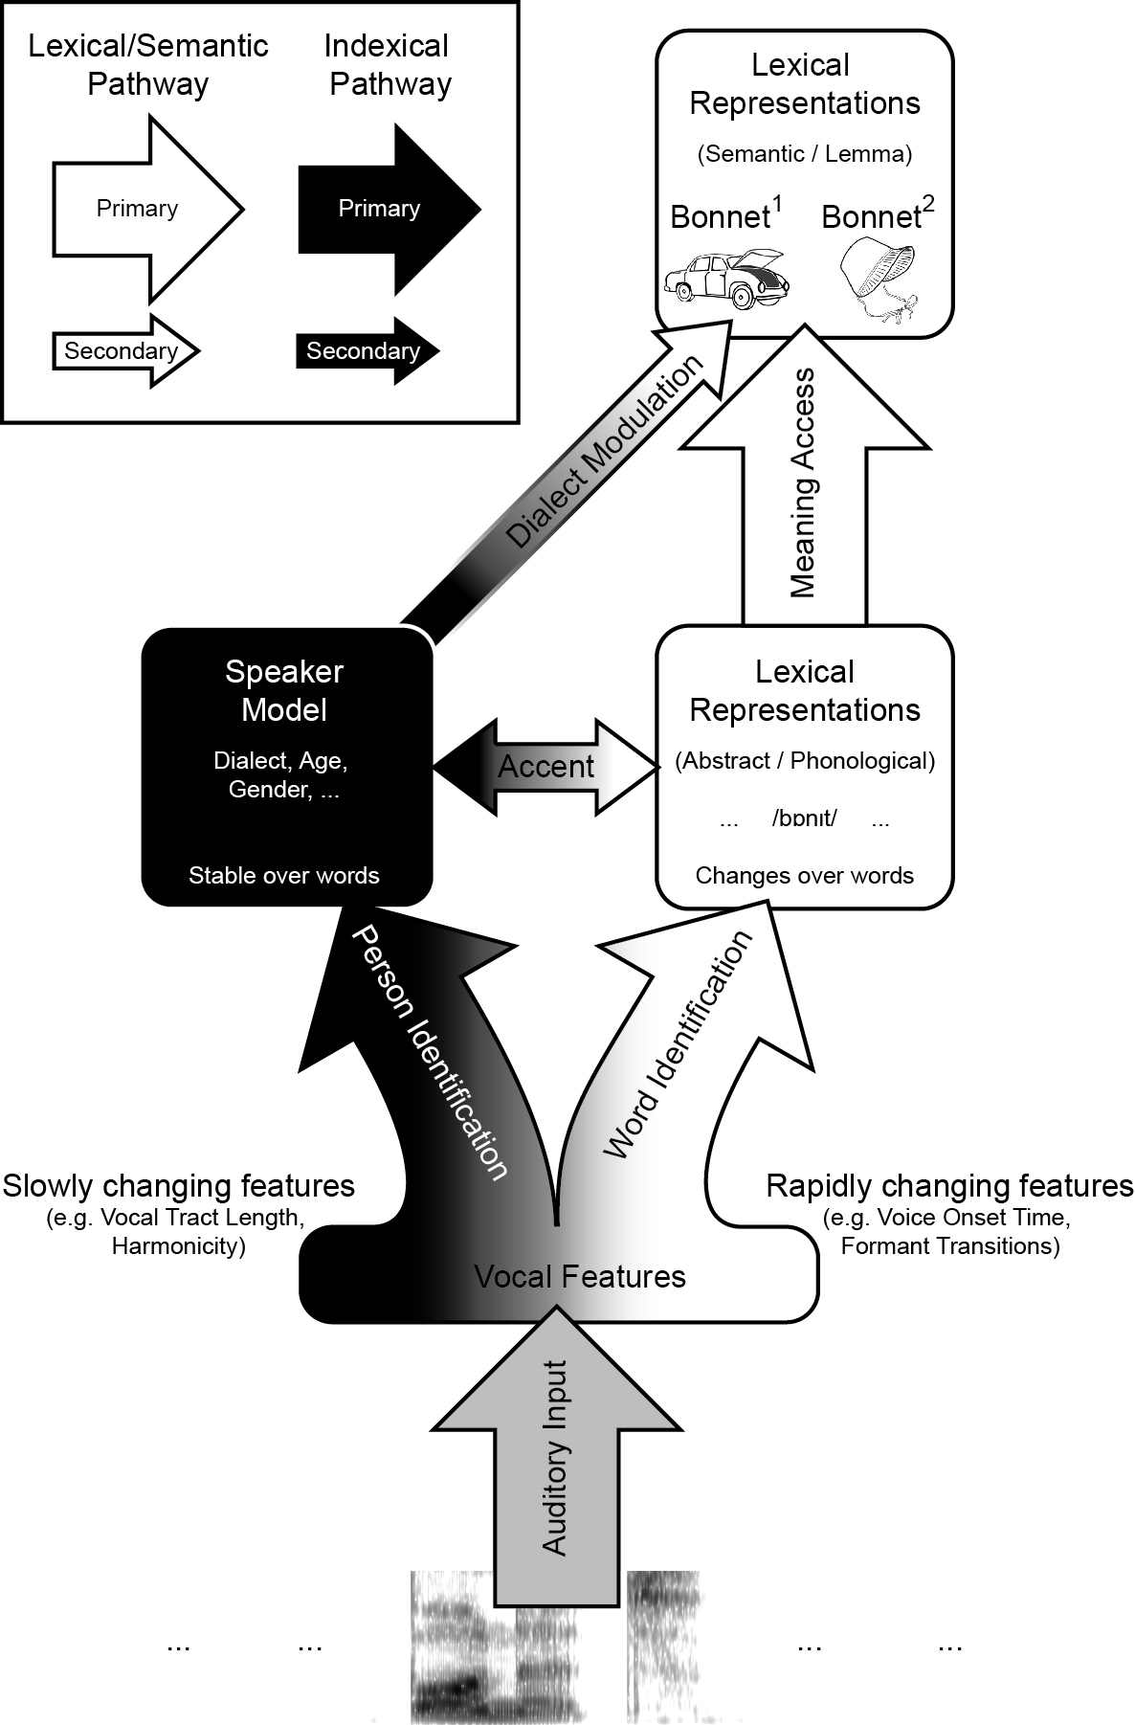
Cai et al. (2017)
Cf. Belin et al., (2004, 2011)

Slide 34
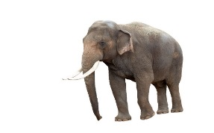


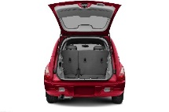
trunk
Conclusions
All words are ambiguous (in context)
Word-meaning access: lexical-semantic settling
Influenced by:
  Structure of stored knowledge
  Cues that predict which meaning likely to be correct
Good ‘lexical quality’ requires constant upkeep in response to changing linguistic environments

Slide 35
Thank You!
trunk

